Slide 1
NEO4J CYPHER TUTORIAL WITH PYTHON
Create Graph From JSON Data Using Neo4j Cypher ,Apoc & Python
Tutorial 82

Slide 2
Sample json data
{name: "DS101", subjects: ["coding", "data_structure", "algorithm"], duration: 1}

Slide 3
Use case
Create Graph From json data using apoc procedure

Slide 4
Pre-requisites
apoc.import.file.enabled=true
apoc.import.file.use_neo4j_config=false

Slide 5
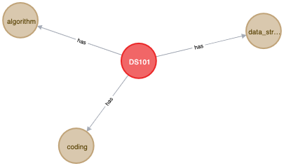
Graph
Expected Graph

Slide 6
code
call apoc.load.json("file:///users/roni/data/sample.json")
yield value
merge (a:EXAM{NAME:value.name,DURATION:value.duration})
with value,a
unwind value.subjects as subject
merge(b:SUBJECT{NAME:subject})
merge (a)-[:HAS]->(b)
From neo4j browser

Slide 7
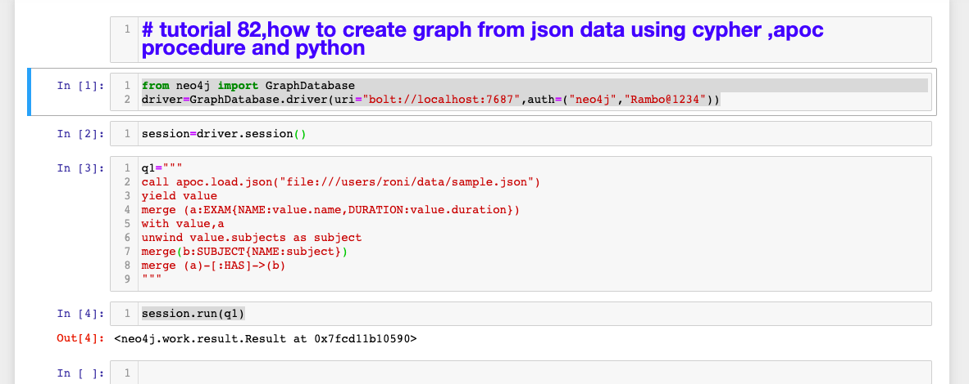
Python code
How to read json file full code

